Slide 1
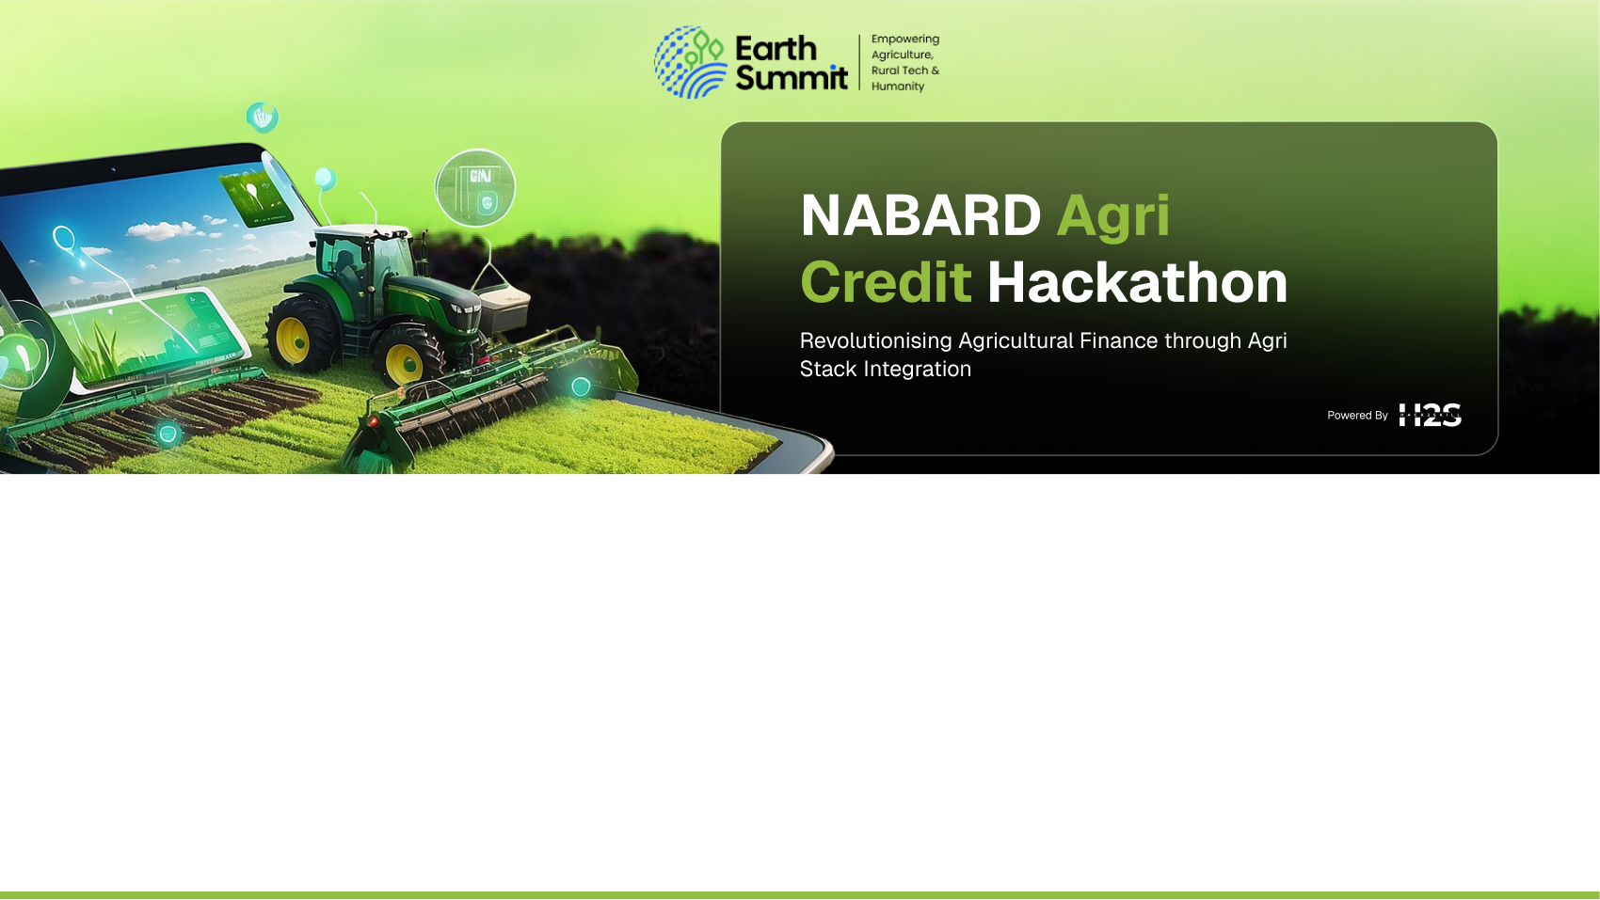
Team Details
  Team name: AgRisk Labs
  Team leader name: Sudarshanam Yessasvini
  Problem Statement: Small and tenant farmers struggle to access formal credit due to lack of collateral and unpredictable crop performance, leading to high NPAs for lenders and financial distress for farmers. Traditional loan systems are static, while agriculture is dynamic — resulting in a Crop–Credit Mismatch.

Slide 2
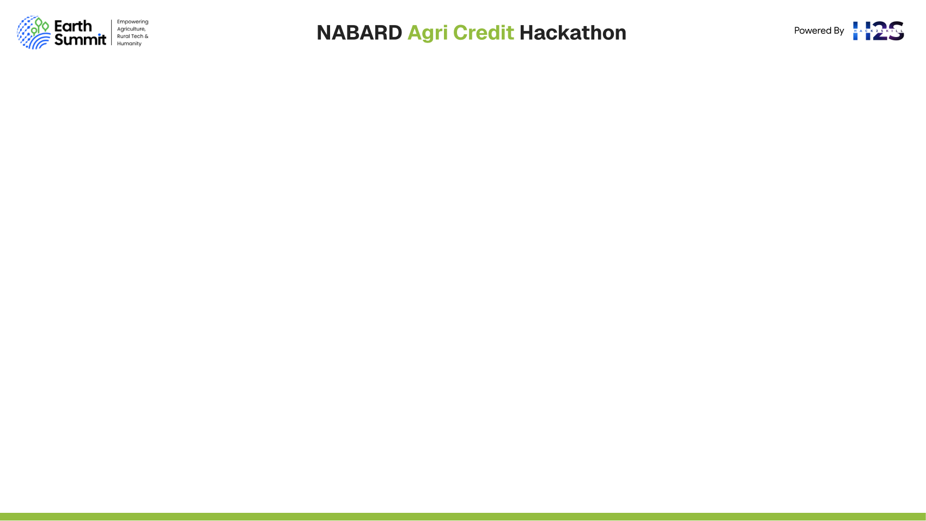
Brief about the idea
Krishi-Patra is a Crop Cycle Linked Dynamic Finance System that creates a Digital Twin of the financed crop using satellite analytics, hyperlocal weather insights, market price feeds, and IoT data.
Instead of giving a loan once and waiting for repayment, Krishi-Patra continuously monitors crop viability and adapts financing dynamically throughout the crop cycle.
Loan terms, top-ups, restructuring, and insurance triggers are driven by real-time crop health and risk signals — reducing NPAs for banks and building financial resilience for farmers.

Slide 3
Opportunities:
How different is it from any of the other existing ideas?
Most existing agri-credit solutions treat lending as a one-time event and evaluate the farmer’s past history rather than the current crop’s viability. After disbursement, there is no risk monitoring, no proactive intervention, and banks discover risk only when repayment fails — leading to NPAs.
Krishi-Patra flips the model:
Instead of judging the farmer, it evaluates and tracks the real-time health of the financed crop using satellite imaging, weather data, soil moisture, price trends and IoT inputs.
Loan scoring becomes dynamic, not static. Credit terms evolve automatically based on live crop risk signals.
This is fundamentally different from scoring APIs or loan management apps — Krishi-Patra is a continuous agri-risk intelligence platform that manages the entire crop-credit lifecycle.

Slide 4
🔹 How will it be able to solve the problem?
Krishi-Patra directly addresses the Crop–Credit Mismatch through:
Predictive risk detection — AI models anticipate crop stress weeks before failure
Proactive interventions — top-ups, restructuring and advisories to prevent distress
Automated insurance activation — catastrophic events trigger claim workflows without manual paperwork
Transparent data sharing on blockchain — removing disputes between farmers, bankers and insurers
Portfolio-level risk intelligence — early warning system for banks to reduce NPAs
This ensures financial resilience for farmers and risk-controlled profitability for lenders, enabling wider and safer credit access for smallholders.

Slide 5
🔹 USP of the proposed solution
Crop Viability Score (CVS): The core metric predicts crop success probability and links it directly to credit decisions, interest rates, and repayment schedules — a first of its kind in agri-finance.
Digital Twin of the Crop: A virtual replica of every financed crop enables continuous monitoring and event-based financial actions.
Crop-Cycle Smart Contracts: Loan disbursements, restructuring, and insurance payouts are governed partly by oracle data (satellite + weather), reducing human delay, fraud and bias.
Regulatory-Sandbox Ready: Natively aligned with Agri-Stack, RBI HaR (Harvest-and-Repayment framework), PSL requirements, and NABARD’s rural credit expansion mission.
Krishi-Patra doesn’t just approve a loan — it protects the crop until harvest.
This is what makes it high-impact, scalable, and financially transformative for the agricultural lending ecosystem.

Slide 6
List of features offered by the solution
List of Features Offered
Digital Plot Productivity Assessment using historical satellite data
Dynamic Credit-Risk Scoring linked to crop cycle
Stage-linked progressive disbursement (sowing, vegetative, flowering, harvest)
Top-up & restructuring options triggered automatically based on risk indicators
Automated insurance settlement — no manual filing by farmers
Portfolio Health Map for lenders predicting NPAs months in advance
Farmer-friendly USSD/IVR interface with green/yellow/red crop status signaling

Slide 7
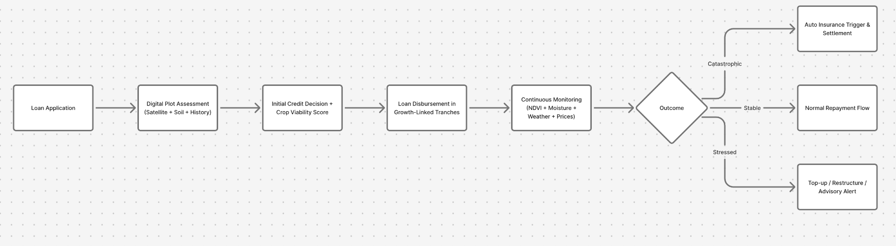
Process flow diagram or Use-case diagram

Slide 8
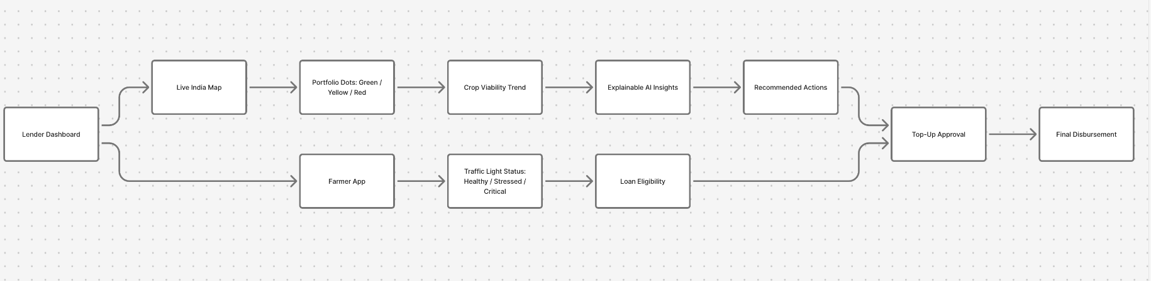
Wireframes/Mock diagrams of the proposed solution (optional)

Slide 9
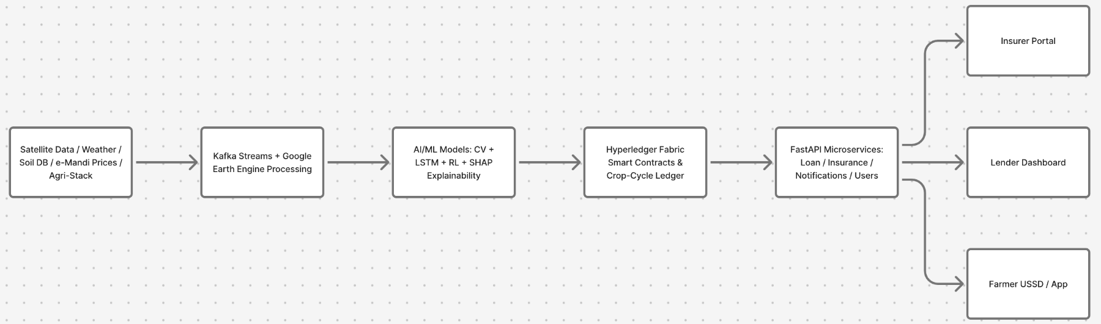
Architecture diagram of the proposed solution

Slide 10
Technologies to be used in the solution
AI/ML: TensorFlow, Google Earth Engine API, XGBoost, Ray RLlib, SHAP
Backend: FastAPI, Apache Kafka, Celery
Database: PostgreSQL, TimescaleDB
Blockchain: Hyperledger Fabric
Frontend: React.js + USSD/IVR integration
Cloud: AWS / GCP

Slide 11
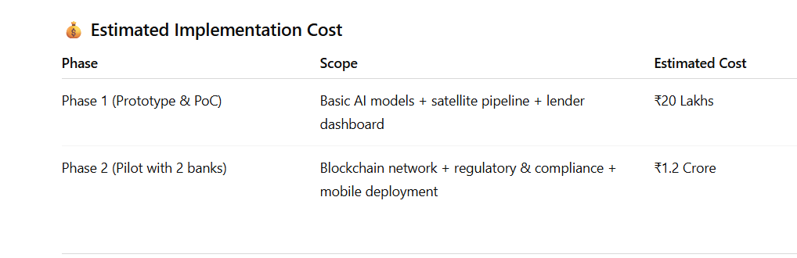
Estimated implementation cost (optional)

Slide 12
Type here…

Slide 13


